Slide 1
SOFTWARE PLATFORM ENGINEERING
From Concept To User Adoption.

Slide 2














ABOUT US
A purpose-driven, cutting-edge global technology solutions platform, focused on delivering best-in-class value to Customers
CUSTOMERS
8+
1200+
350+
600+
10
9+
Years of
Excellence in Delivery
Tech
Experts
Global
Customers
Successful
Projects
Distributed
Delivery Centers
Cutting-edge Tech Solutions Expertise
Global
Enterprises
POWERED BY
ENTREPRENEURS
TALENT
i2i WAY
Cutting-edge Tech
Companies
Proven metro and smart town Entrepreneurs
Solid delivery expertise
Talent on the cutting edge
Deep technical expertise
Work from office in hometown
Innovation at the core
Centered in value delivery
Ownership of outcomes

Slide 3


















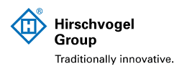


















i2i technical Solutions
Software Platform Eng
Industrial IoT
Data Annotation
Quality Engineering
SAP
Fasttrack MVP Development
Product Roadmap Engineering
Scalability and Performance Optimizations
Application Development, Maintenance & Support
Product Quality Assurance
Consult & Strategy
Tech Assess & Selection
Solution Design & Impl.
Ongoing Maint. & Supp
Cyber Risk Mgmt
Performance Monitoring & Optimization
Image, Video, Text Annotation
Metadata Mapping
Maps & Data Set Creation
Data Utilities & Tool Creation
Test Automation
Manual Testing
Performance Testing/ Engineering
Security Testing
Consulting
Implementation & Rollouts
Support & Enhancements
Infrastructure Management
CIOaaS
Training & Enablement
AI/ML & Data Analytics
Salesforce
UX/UI Design
Cloud
Cybersecurity
Data & AI Advisory & Consulting
AI/Gen AI PoC Factory
Data Engineering
Data Science
Adv Analytics
NLP, Speech Rec, Comp Vision
Business Consulting
E2E CRM Impl.
Integration Services
Managed Services
App/Product Development
Salesforce Talent Building
User Research
Idea to Clickable Demo
MVP Outlining & UX Design
Customer Experience Design
Visual Exp. & UI Design
Design System for Products
Cloud Migration
Cloud Consulting
Managed Services
Cloud Engineering
Cloud Integration
Cyber Trainings
Managed Security Services
Cyber Security Product Service

Slide 4










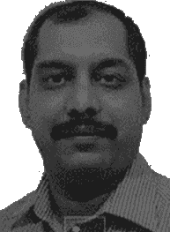
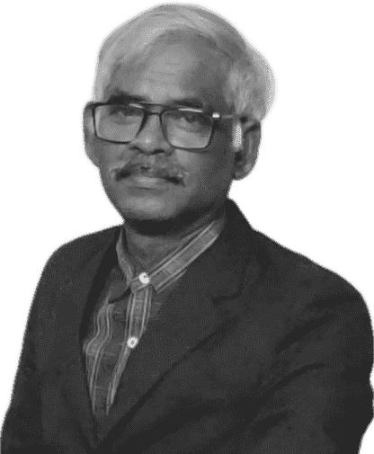













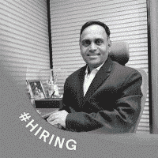

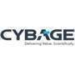





Our MANAGEMENT TEAM
DIVERSE IN EXPERIENCES, UNITED BY PURPOSE
Gireendra Kasmalkar
Anshoo Gaur
Raosaheb Shinde
Founder and Chairman
Co-Founder and Group CEO
Board of Director
Software Platform Engr.
SOFTWARE PLATFORM ENGINEERING BU LEADERS
Niranjan Mahabalappa
Tejas Limaye
Lakshmanaraj S.
Sandeep Jadhav
CEO
Software Platform Engr.
CTO
Software Platform Engr.
Product Owner
Software Platform Engr.
Engineering Head
Software Platform Engr.
OTHER BU HEADS
Chandrashekhar Deshmukh
Jitendra Sharma
Rohan Jadhav
Sambhaji Chawale
Business Head
IoT/IIoT
Business Head
Quality Engineering
Business Head
Data Annotation
Business Head
SAP

Slide 5
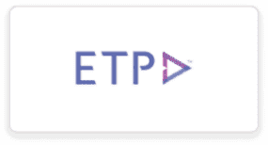
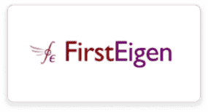




























OUR CLIENTS

Slide 6













i2i’S UNIQUE WAY OF WORKING
OPERATIONLIZING AGILITY
Lead With Design Thinking
Innovation DNA
PoC First
Product Mindset
Customer Embed
User Empathy
Spot Strategic Launchpad
Validation through Experimentation
The Solution is a Tangible Product, with a Clearly Defined Strategy Aligned to Business Value
KYC Mastered by Every Employee
Holistic Assessment
Illuminate - Innovate - Implement
Invented Everywhere Mindset
Rapid Prototyping
Customer-i2ip Exchange Program
Accelerated Decision-Making
Openness to Change
Features Directly Targeting User Needs
Unified Brilliance: Diverse Expertise, One Team
Unified Solution Architecture
Diverse Perspectives
Minimum Viable Product (MVP)
Prioritizing Features for Expedited Time-to-Market
Cross-Functional Collaboration
Cultivate a Culture of Curiosity
Integrated Customer Engagement
Iterative Implementation
Rapid Incremental Outcomes
Agile Incremental Deliveries
Design for Seamless Scaling and Operational Ease
Harnessing Profound User Insights in Development
Co-Creation Initiatives
User Community Building
01
02
03
04
05

Slide 7
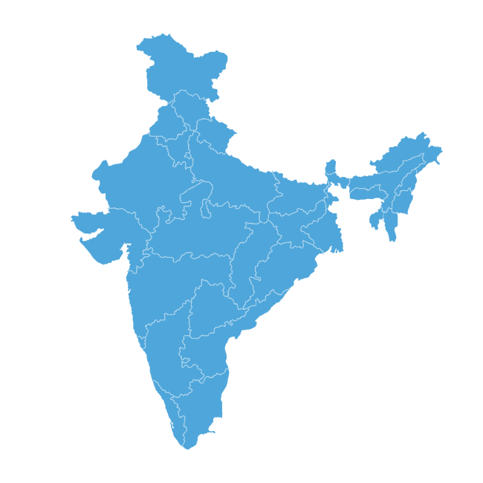



i2i engagement model
FOCUSED ON SOLUTION & FASTER TIME TO MARKET FOR OUR CLIENTS
Ownership Based
Model
Capacity-based
Model
Dedicated
CoEs
i2i Delivery Sites & CoEs
01
02
03
Fixed Price Project
Scrum Team
Managed Service
Complete delivery & risk ownership for a fixed price on milestone basis
Multi skilled team with defined deliverables at a fixed monthly cost
Enable rapid technology adoption
Location strategy - India’s top 10 emerging tech hubs
Pricing model – T&M, fixed, and hybrid
Output-based
Core n Flex Model
BOT
Minimum unit delivered per month @price per unit (e.g., story point)
Dedicated core team of specialist at fixed monthly cost.
Flexible team of varying skill on T&M to manage demand fluctuation
Compelling ROI & faster TTM
Full control over teams, business ownership, and delivery​
Duration – 1 year to 3 years
Associated Smart Town Layer
Metro Locations
CoEs

Slide 8






ESG BY DESIGN
Work From Home-Town (WFHT)
Sustainable
Tech-Enabled Economic Development
Carbon Footprint Reduction
Enhanced Quality of Life (QoL)
Improved Mental Health
Elevated Social Engagement Quotient
Empowerment of Women
Equitable Distribution of Job Opportunities
Empowers Communities
Fosters Entrepreneurship
Reduces Environmental Damage
Minimizes Commuting
Mitigates Urbanization

Slide 9

SPE capabilities

Slide 10



i2i SOFTWARE PRODUCT ENGINEERING
TURNING IDEAS INTO SCALABLE PRODUCTS
01
02
03
IDEAS TO MVP
PRODUCT BUILD & SCALE
PRODUCT CoEs
i2i Recipe
i2i Recipe
i2i Recipe
Product Road Mapping And Product Management
CTOaaS
Develop PoC and MVP
Product & Platform Engineering
UI/UX
Product Modernization & Expansion
Last Mile Solutions
Scalable Platform Architecture
Offers well-equipped CoE in India for product excellence
QE & Product Team
Scrum teams as customer team extension
Mentoring and guidance by tech experts
Resource Optimization and Scalability
Customer Outcomes
Customer Outcomes
Customer Outcomes
POC & MVP
Faster TTM
Best-in-class Experience
Reduced TCO
Product Optimization
Faster TTM
Best-in-class Experience
Cost-Effective Resource Utilization
Reduced TCO
Faster TTM
Cost-Effective Resource Utilization

Slide 11




DATA Quality as a Service
What would have taken my team of 10 Engineers 2 years to do, this service could deliver in <8 weeks”
We oversee the data integrity of essential assets, proactively identifying and mitigating any questionable data, thereby relieving your business partners from the need to address such issues.
- VP Technology, Enterprise Data Office, Top-20 US Bank
Resources
Best practices
Accelerator
Build Internally
High investment
Long time
Hire specialized internal resources
Endure the long learning curve
+
Buy Product
01
03
05
Long evaluation time
Learn the s/w
Train internal resources
Endure the long learning curve
Project risk
Minimal data expert involvement
Trust Reports 500* tables (or more) in 30 days
Streamline data operations
02
500* tables with 5 resources
04
Buy Service
Minimal IT team involvement
High data trust & user engagement
Award winning Accelerator
No project risk- Production in 2 months
No learning curve
Trained Ninjas
Deploy best practices

Slide 12










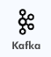





































Technology Stack
Full Stack
Data Engineering
DevOps & Quality
SOFTWARE PLATFORM
ENGINEERING
Cloud
Platform
AI/ML
Design/
prototyping

Slide 13




Customer Testimonials
OUR CUSTOMERS SAY IT BEST
“It's been a great journey so far and your effort and dedication over the past year were paramount in making it a success. Well done! May our collaboration continue to thrive and bring even greater success in the future.”
"I would like to appreciate the efforts of the team and their unique skills for automating the process using SOLIDWORKS API and managing the project efficiently. The team composition proposed by i2i has proven to be a success, and we are planning to scale the team even further."
- Aniket Raje, Director Product Management & Engineering at Impact Systems
- CTO, US-based CAD Software Development Company

Slide 14








case Studies - Ideation
Industry
Financial Services
Industry
Education & Consulting
Headquarters
Hong Kong
Headquarters
India
PROBLEM STATEMENT
PROBLEM STATEMENT
Develop blockchain-based gifting solutions that will revolutionize gifting
Create tokenized assets with enhanced security, flexibility and superior experience
Accelerate time to market
State Governments organize sports events for teams in schools.
Lack of a feature-rich and easy to use portal for teams in school to know events / register and see results
Objective – Increase effectiveness
OUTCOMES DELIVERED
OUTCOMEs DELIVERED
Designed tiered component architecture consisting of BFF layer, commerce layer, Core services layer and web3 layer
Curated the MVP features for accelerate time to market and demonstrate value to investors and potential corporate clients
World-class user experience design for the portal
Fully functional, cross-platform (web +mobile) based portal

Slide 15
case Studies - Modernization
Industry
Prediction & Ecommerce
Industry
Manufacturing
Headquarters
Pune
Headquarters
Australia
PROBLEM STATEMENT
PROBLEM STATEMENT
Client – AstroApp - Existing app with legacy technology had challenges such as scalability, ease of operation and maintainability
The user experience was not satisfactory, limiting the user base expansion
Client has plan to expand services globally that need significant facelift to the app and changes to suit global market
Challenges in customer experience for tech support areas
Legacy proprietary platform that has severe limitations to leverage new technology and agility
Growing business needed a comprehensive IT Roadmap to establish the right IT systems and services
Technology leadership and capacity challenges for development
OUTCOMES DELIVERED
OUTCOMEs DELIVERED
Established technology leadership team and capacity building at offshore
IT roadmap and architecture to provide omni-channel service portal and mobile app
UX design for better user experience
Reengineered the work business flow and algorithm for better efficiency
Redesigned the UX and UI for world class user experience
Build new features to increased value added services and asset monetization
Notes:
Need to add numbers in place of x and y

Slide 16
case Studies - CoE
Industry
Retail
Industry
Software Product
Headquarters
Singapore
Headquarters
United States
PROBLEM STATEMENT
PROBLEM STATEMENT
The customer wanted a long-term development and testing partner to add and enhance their product suite's functionalities and provide customization services for their end clients. ​
They also needed support with functional testing for their payment gateways, mobile apps, and other new tools developed internally.
Expert deep tech abilities were not internally available with customer for Scalability and Performance Testing ​​
The client envisioned a product, Databuck, to automate validation of quality and integrity of data and be able to handle petabytes of data without scaling issues.​
Key requirements - Service provider to support in product development, implementation and post-implementation activities at global level. ​ Support for major/minor enhancements and bug fixes related to the UI module and core engine.
Lack of leadership in India
OUTCOMES DELIVERED
OUTCOMEs DELIVERED
Significant cost reduction for the client by employing internal i2i resources. ​
Achieved quicker response time and faster go-to-market. ​
Ongoing support for major and minor module additions and bug fixes.​
Provided CTOaaS and executed critical performance tunning, architecture reviews and fixed to ensure business objectives to process >6MN orders / day is achieved.​
A significant reduction in TTM, enhancement in product quality, release stabilization, and defect detection.​
Robust development and implementation framework allowed for enhanced frequency of upgrades and new feature releases.​
Addressed challenges associated with product scalability through the implementation of innovative development ideas.​
Provided CTOaaS service and appointed operational head in India for the customer

Slide 17





Why i2i?
RCA Experts
Product Engineering DNA
Design, Develop, Modernize And Manage Your Software Portfolio For Unique Business Advantage.
Lead With Design & Innovation
Seasoned Leaders
Faster Time-to-Market

Slide 18
“ACCELERATING THE FUTURE OF WORK THEREBY,
DISTRIBUTING THE FUTURE EVENLY”
www.ideastoimpacts.com
info@ideastoimpacts.com

